Slide 1
MOOC and the flipped classroom
An Introduction to Computer Networks
Fall 2012
Nick McKeown

Slide 2
Three takeaways (for me)
MOOCs are immensely rewarding.
Not sure we have the model right yet:
We are essentially summarizing textbooks in video form.
The flipped classroom offers interesting new opportunities.

Slide 3
History
History of CS144
  A first course in networking.
  Offered by Phil Levis + DM for 5 years.
  Two lectures per week + 5 programming assignments, midterm, final.
  About 50:50 BS and MS students.
  Material is mostly descriptive (layering, protocols, principles), with small amount of math and algorithms (Dijkstra, Bellman-Ford, WFQ, basic queueing theory).

Slide 4
High level: Fall 2012
MOOC + On-campus (flipped classroom).
Goal: Same level and depth as previous CS144.
Co-taught by Phil Levis and me.
MOOC: 35,000 enrolled, 2,000 completed.
MOOC compressed to 6 weeks.
On-campus: 133 enrolled + SCPD students.
Same videos/quizzes for both: 86 videos, 7-21mins.

Slide 5
On-campus Student Workload
Watch 8-12 videos per week.
Class time:
  1 mandatory talk per week by outside speaker.
  1 optional session with group assignment.
  5 optional sections by TAs per week.
4 programming assignments
2 problem sets
1 writing assignment
Midterm + Final

Slide 6
MOOC Student Workload
Watch 12-15 videos per week (same videos).
Watch 1 “screenside chat” per week.
No programming assignments.
2 problem sets (for assessment).
50% of students who completed received “Statement of Accomplishment” (1,000).
In 2013: Assess quizzes, add 1-2 programming assignments, spread MOOC over 10 weeks.

Slide 7
Technology/Platform
Class2Go
  Open-source platform.
  Manages video posting, in-video quizzes, online assignments, web page.
  Integrates with: YouTube, Piazza.
  Started by John Mitchell.
  Dev team in Gates building, led by Jane Manning.
  Super responsive team.
  Platform is very stable and easy to use.
  We plan to use it again.
  Less visible than Coursera and others.

Slide 8
Technology/Platform: Videos
Videos recorded in ScreenFlow on Mac.
  Free for recording/editing; $29.95 to export.
  Easy mixing of video, audio, powerpoint/pdf.
  Very easy to learn and use.
  Phil/I recorded videos (~1hour to record 20mins).
  TA edited and exported (~2hours per 20mins).
  Use an HD webcam ($100 Logitech).
  Use a good microphone ($150 Yeti).
  Use a tablet with built-in screen ($1,000 – loaned).
  Same setup at home and in Gates.

Slide 9
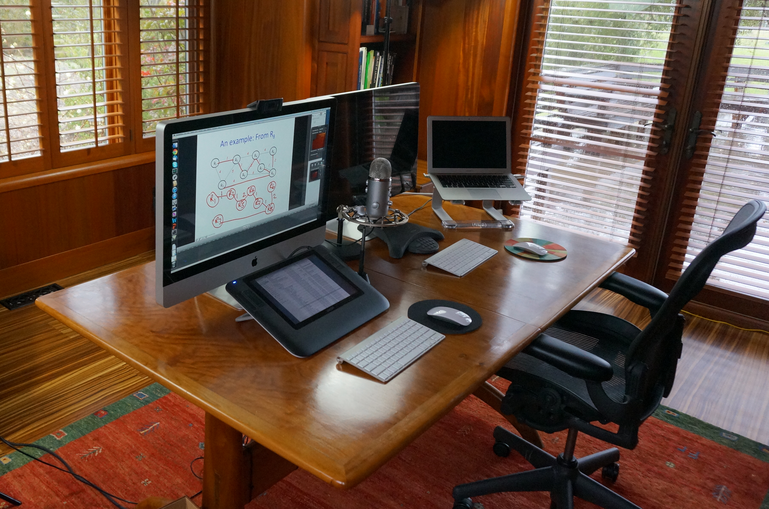
Home office setup

Slide 10
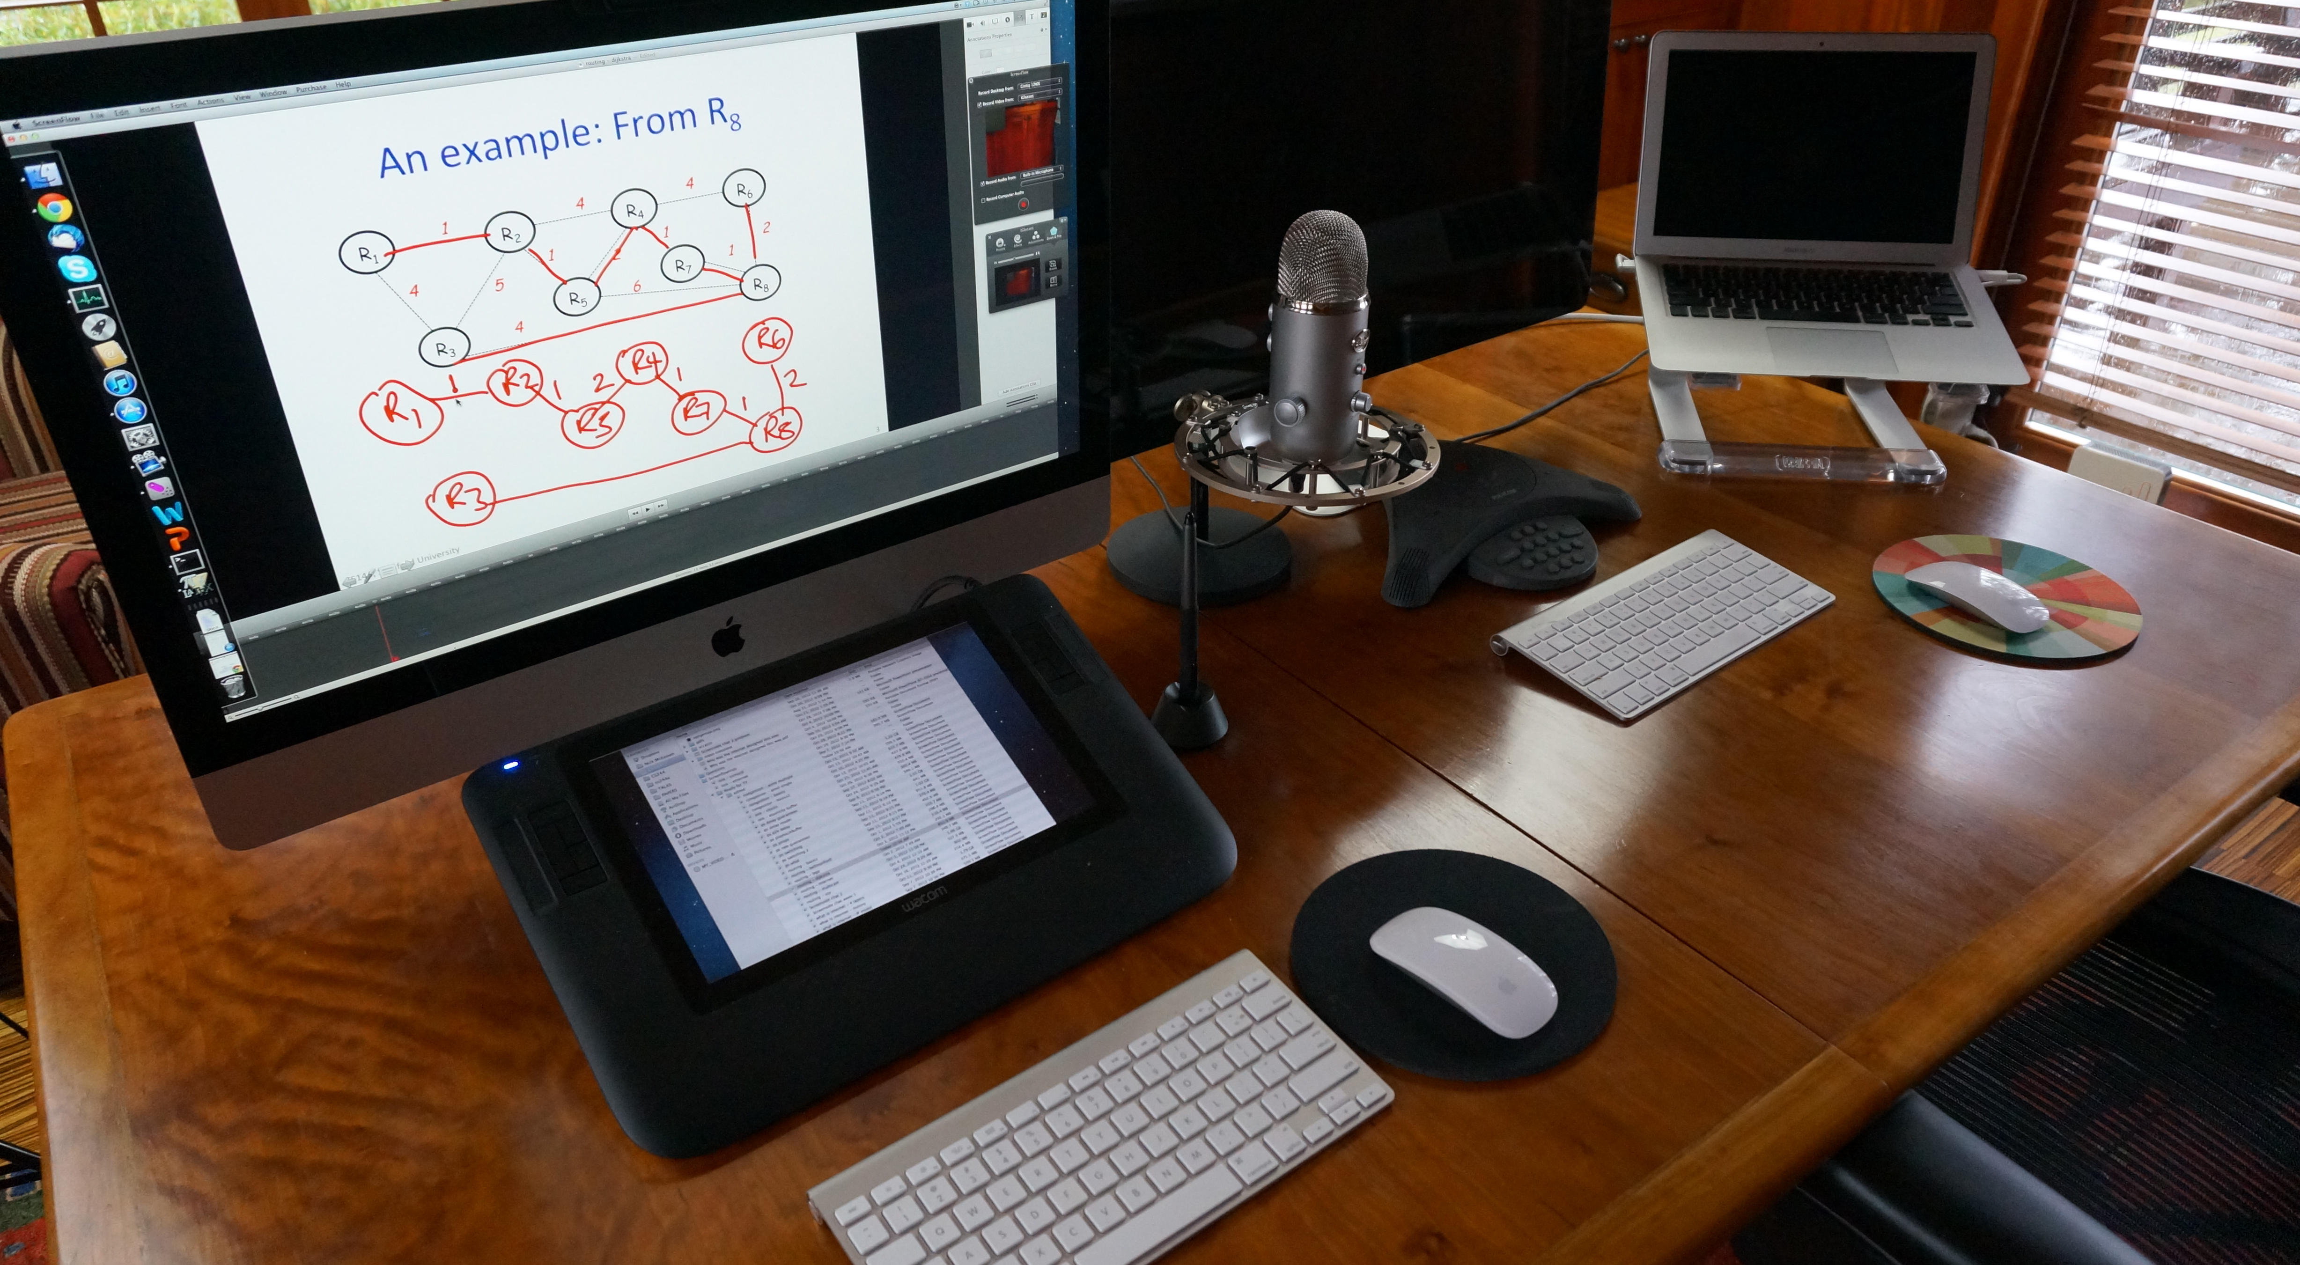

Slide 11
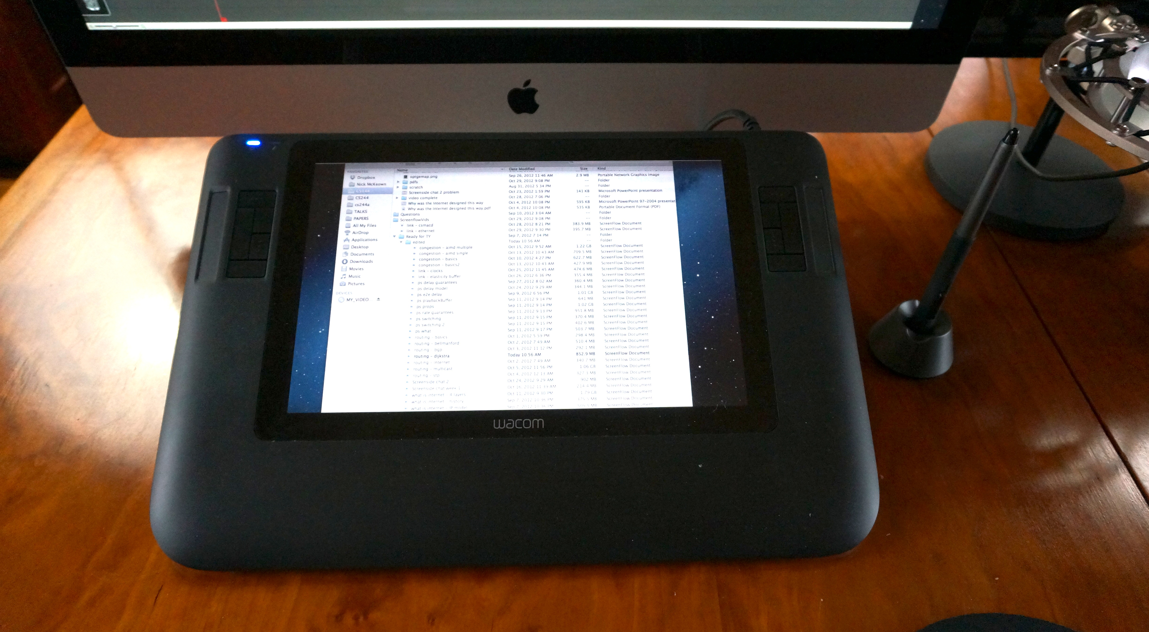

Slide 12
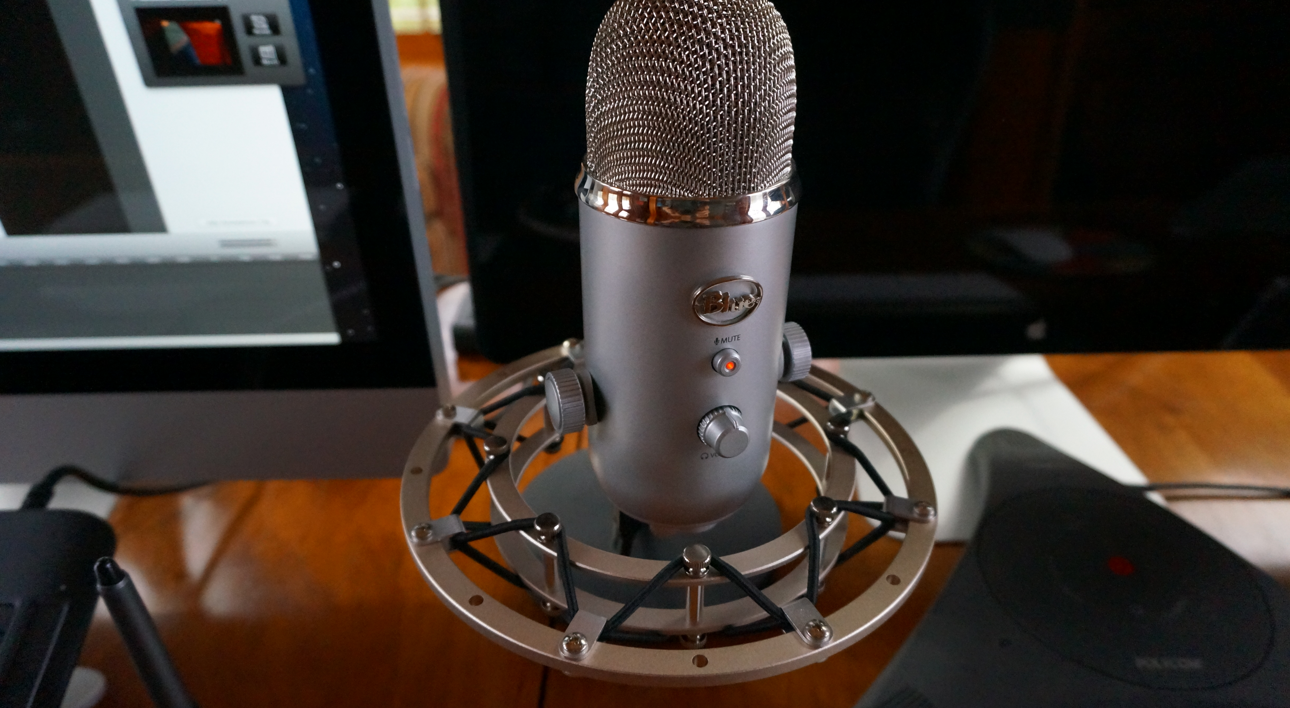

Slide 13
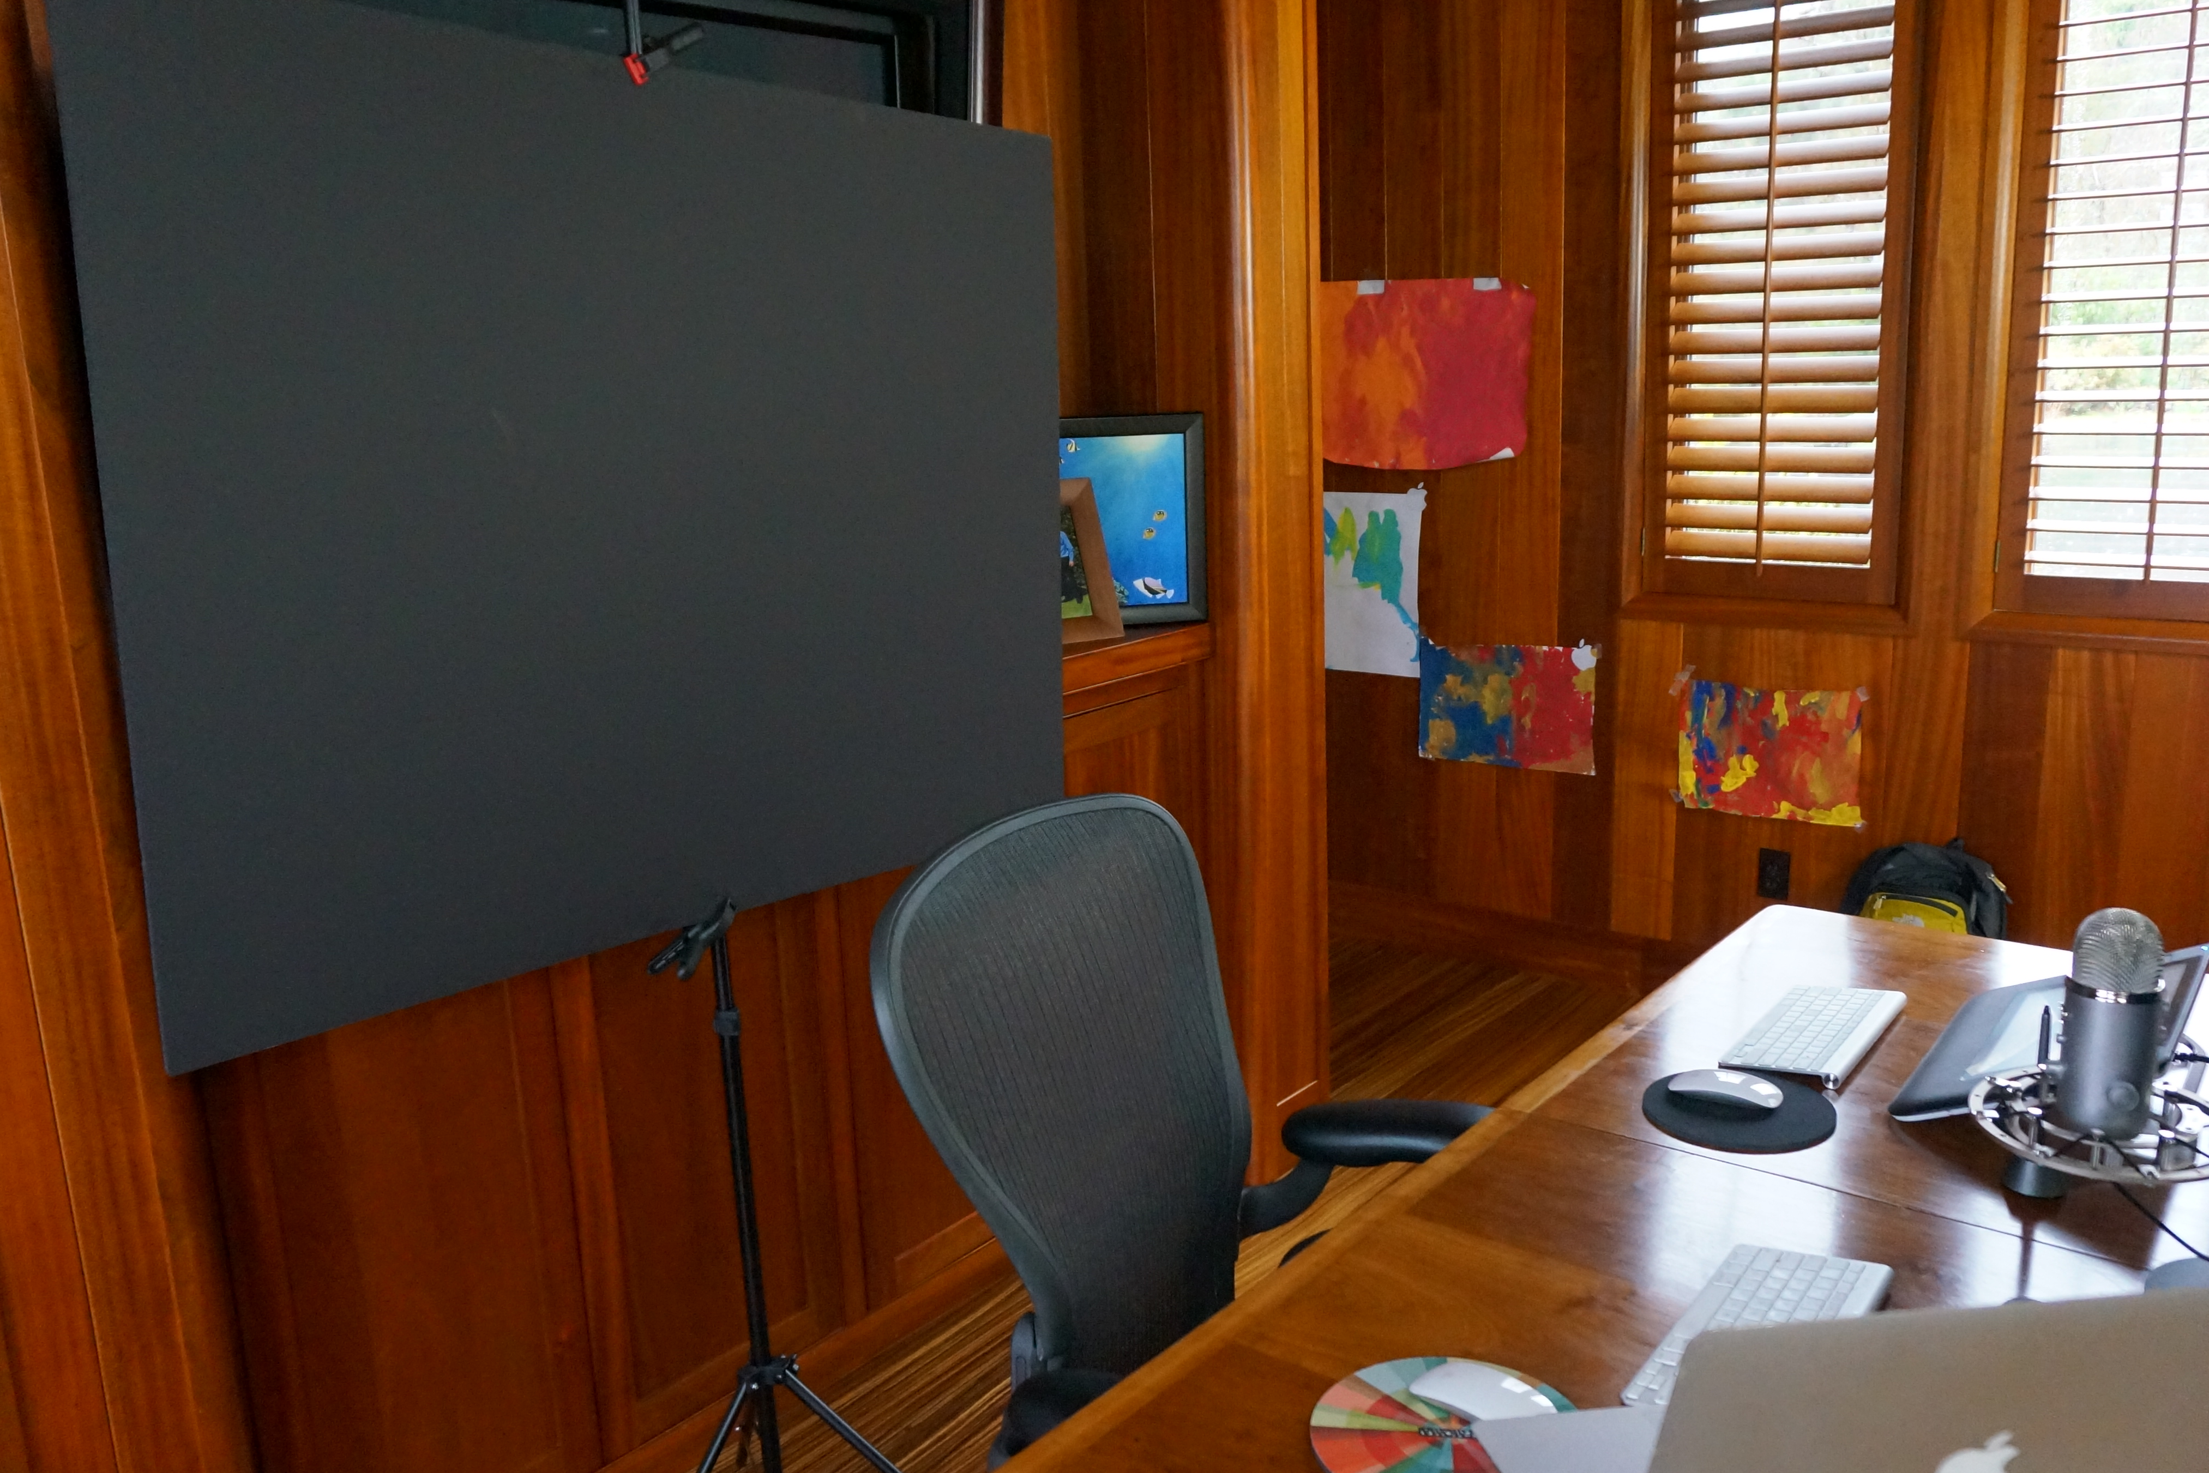

Slide 14
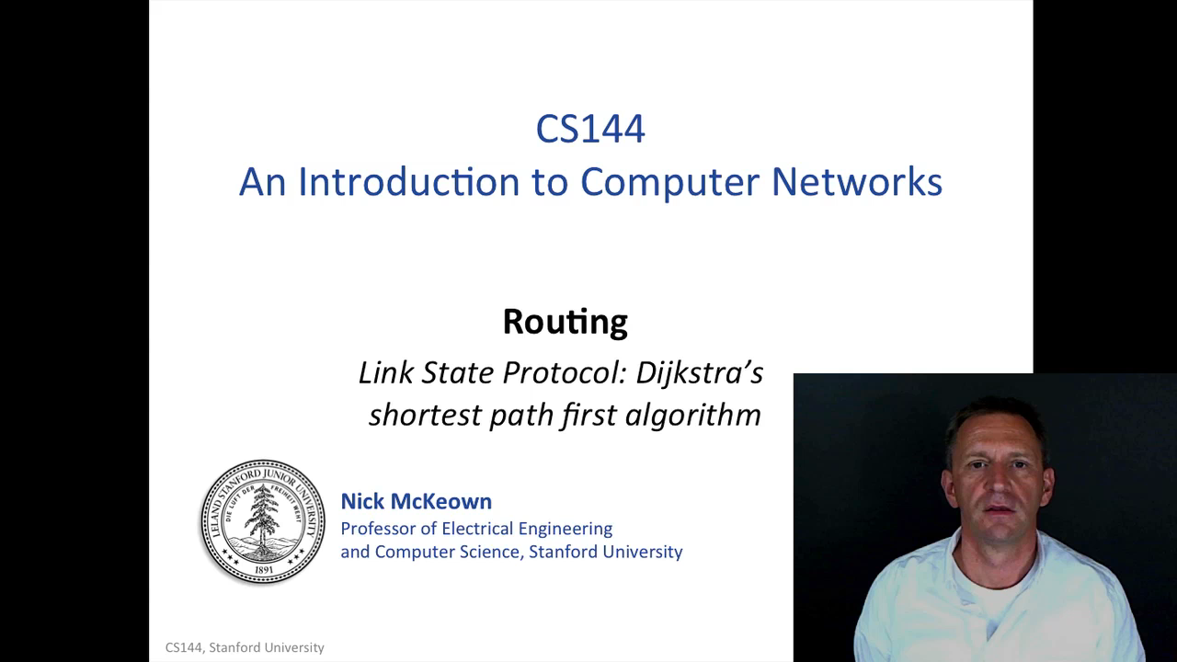

Slide 15
What the students saw
CS144 on campus
MOOC

Slide 16
Other technology
Dropbox for all video and slide development.
Github for quizzes, assignments and captions.
Google docs for workflow and grading (6 TAs).
Takes about 1 week from edited video to posting online.

Slide 17
Flipped Classroom time
3 sessions of problem solving and Q&A.
  Students like this. We are in two minds.
7 sessions of self-contained group exercise
  Wireless laptop and wireshark.
  Map out Stanford campus.
  Multipath traceroute.
  …
Good:
  Got to know twice as many students.
  More interaction among students.
Will improve next time:
  Keep assignment within 1 hour class.
  Will make part of their grade.

Slide 18
MOOC: Observations
Few surprises and immensely rewarding.
Volume of postings is colossal
  40 videos watched in first 30mins.
  600 forum postings in first 24 hours.
  1 dedicated TA to post and monitor forum.
  I looked at it every 2-3 days.
Students love to help each other.
Etiquette takes some getting used to.
Flying top student here for lunch.

Slide 19
High level recommendations
Start 6+ months ahead and make videos regularly.
Try not to make videos during the quarter.
Generate quizzes as you go.
Have the quizzes part of the final grade for everyone.
Weekly screenside chats.
Regular communications to MOOC students.
Find a TA who will edit videos and add quizzes.
Don’t plan to do much else the 1st quarter.

